Slide 1
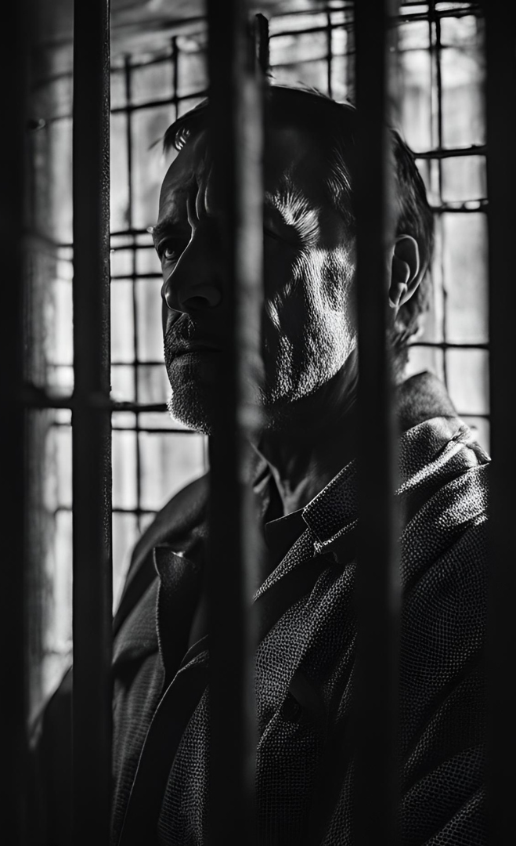

Boston Crime Incident Analysis
(2018-2022)
Group Number - 5
Professor: Roy Wada
Presented by: Kumar Saransh
Nishanth Nagesh
Yunong Li
Northeastern University: College of Professional Studies
ALY 6015: Intermediate Analytics
10th December, 2024

Slide 2
Table Of
CONTENTS
1
4
LOGISTIC REGRESSION MODELING
INTRODUCTION
2
VISUALIZATIONS
5
RECOMMENDATIONS
3
CHI-SQUARE TEST
6
CONCLUSION

Slide 3

INTRODUCTION
Our analysis utilizes a dataset sourced from the Boston Police Department's crime incident reports, which includes key details about crime incidents from 2015 to 2024. This presentation focuses on the years 2018, 2020, and 2022. We employ descriptive statistics, visualizations, and logistic regression modeling to uncover meaningful patterns.
Dataset: Boston Police Department crime incident reports (2018-2022).
Analysis Techniques: Descriptive statistics, visualizations, Correlation, Chi-Square Test, logistic regression modeling.
Offenses more prevalent in each district
Areas with highest frequency of shootings
Is there any seasonal pattern
Day of the week trends
Impact of time of the day
INTERESTING
QUESTIONS

Slide 4
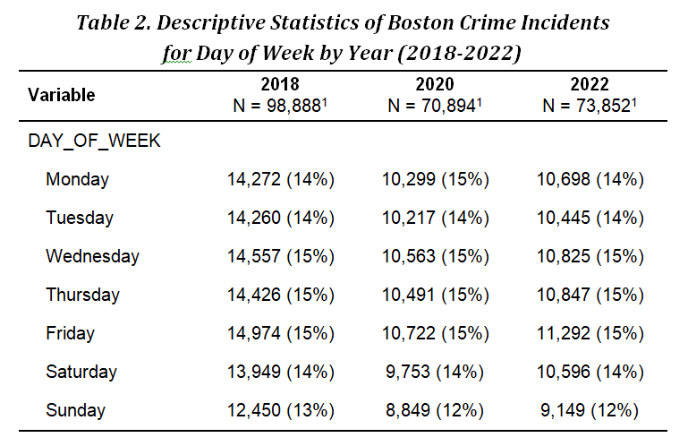
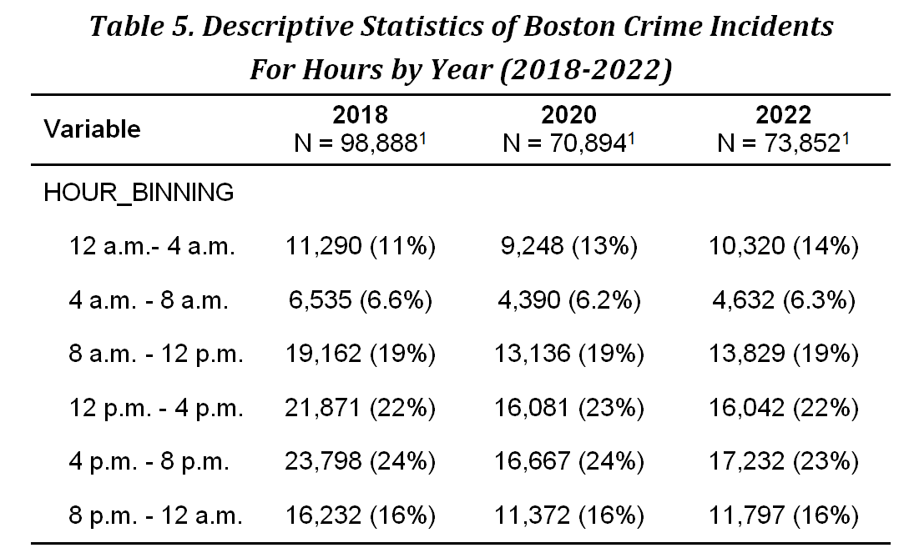
Descriptive Statistics Summary
Crimes decreased from 2018 to 2020 but rose in 2022.
High-crime districts: Roxbury, Dorchester, Mattapan
Crime peaks: Fridays and weekend, evenings (8 PM - 12 AM)

Slide 5
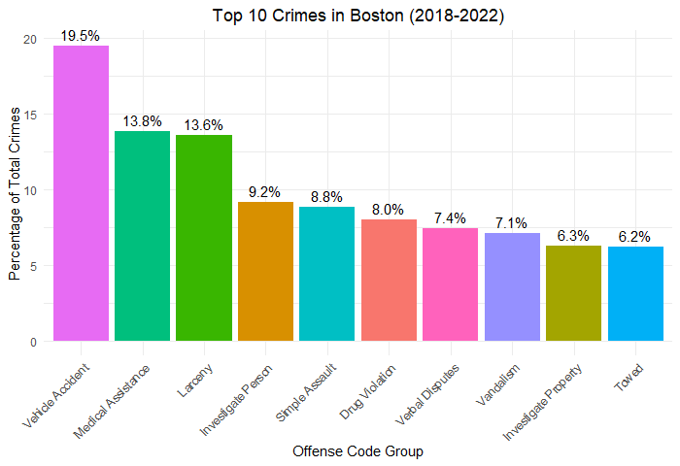
TOP 10 CRIMES IN BOSTON
Overall Observations:
Vehicle Accidents and Medical Assistance are the two most frequent crime categories, accounting for 19.5% and 13.8% of total crimes, respectively.
Larceny, Investigate Person, and Simple Assault are also relatively common.
Auto Theft and Violations are among the least frequent categories.

Slide 6
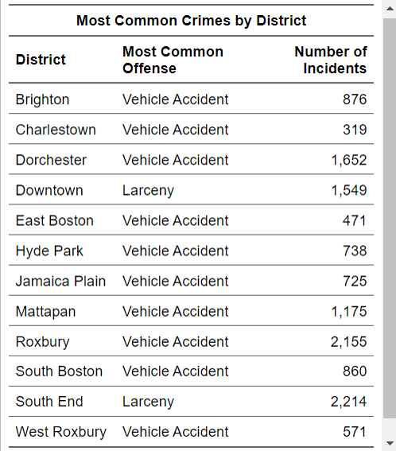
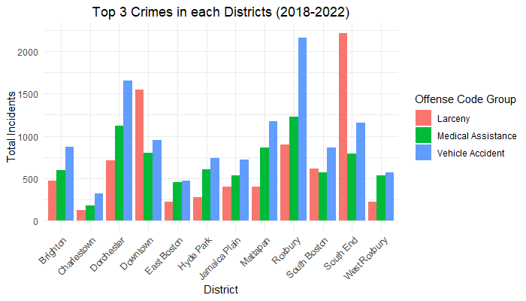
OFFENSES MORE PREVALENT IN EACH DISTRICT
Overall Observations:
Vehicle Accidents are the most common offense in most districts.
However, there are exceptions. In Downtown & South End, Larceny is the 2nd most common offense.

Slide 7
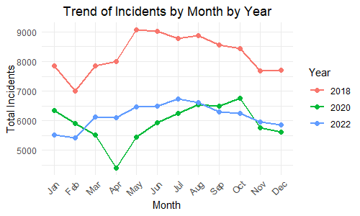
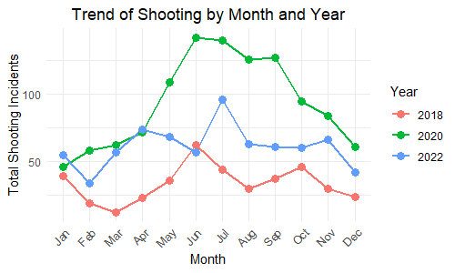
SEASONAL PATTERN OF CRIMES
Overall Observations:
Seasonal Variation: There seems to be a seasonal pattern for both incidents and shootings. The number of incidents and shootings tends to peak in the summer months (June-August) and decrease in the winter months (December-January).
Year-to-Year Comparison: Comparing the years, the total number of incidents has gradually decreased over years where as the number of shooting has increased over years.
Shooting Incidents: The number of shooting incidents is significantly lower compared to total incidents, suggesting that not all incidents result in shootings.

Slide 8
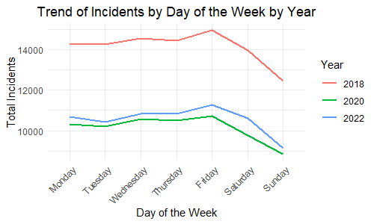
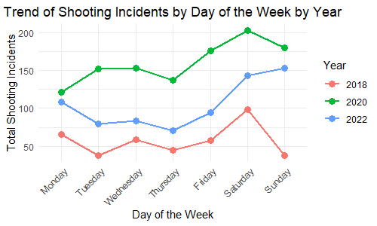
DAY OF THE WEEK TRENDS
Overall Observations:
Day-of-Week Trend: total number of incidents occurs more weekdays and less in weekends where as shooting incidents occurs more in weekends and less in weekdays.
Year-to-Year Comparison: Comparing the years, the total number of incidents has gradually decreased over years where as the number of shooting has increased over years.
Shooting Incidents: The number of shooting incidents is significantly lower compared to total incidents, suggesting that not all incidents result in shootings.

Slide 9
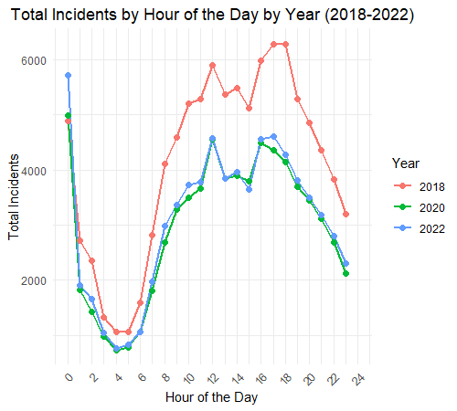
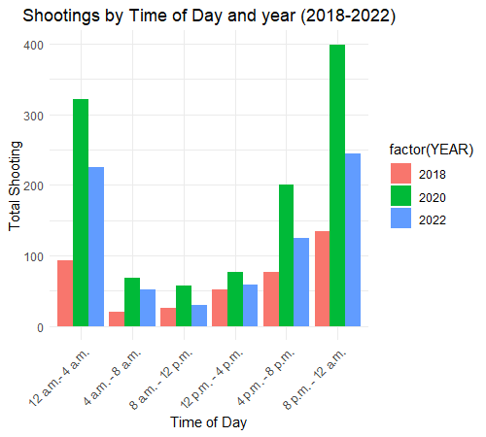
IMPACT OF TIME OF THE DAY
Overall Observations:
Day-of-Week Trend: total number of incidents occurs from 6 A.M. to 6 P.M. where as shooting incidents occurs from 8 P.M. to 12 A.M.
Year-to-Year Comparison: Comparing the years, the total number of incidents has gradually decreased over years where as the number of shooting has increased over years.
Shooting Incidents: The number of shooting incidents is significantly lower compared to total incidents, suggesting that not all incidents result in shootings.

Slide 10
SHOOTING TRENDS: TEMPORAL PATTERNS
Seasonal Variation
Higher shooting incidents during warmer months (May-September).
Time-of-Day Influence
Evening hours (8 PM - 12 AM) exhibit a significant increase in shootings.
1
2
3
Day-of-Week Patterns
weekends tend to have higher shooting rates.

Slide 11
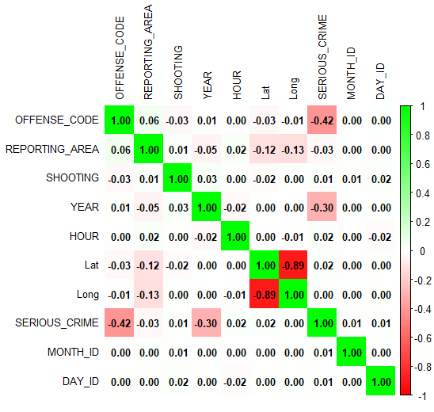
CORRELATION TABLE
LAT and LONG: Strongly negatively correlated (-0.89), suggesting that as latitude increases, longitude decreases.
OFFENSE_CODE and SERIOUS_CRIME: Moderately negatively correlated (-0.42), suggesting that higher offense codes might be less likely to be classified as serious crimes.
YEAR and SERIOUS_CRIME: Moderately negatively correlated (-0.30), suggesting a potential decrease in serious crimes over the years.

Slide 12
CHI-SQUARE TEST FOR ASSOCIATION BETWEEN DISTRICT AND SHOOTINGS
The test evaluates if the distribution of shootings across districts is independent or if certain districts are more prone to shootings.
Framing Hypothesis:
H0: There is NO association between the district and the occurrence of shootings (The distribution of shootings is independent of the district).
H1: There is an association between the district and the occurrence of shootings (The distribution of shootings depends on the district).
Test Statistic (X²) | DF | P-value | Decision
1258.6 | 12 | < 2.2e-16 | Reject the null hypothesis
Decision:
Since the p-value is extremely small (2.2e−16 < 0.05), we reject the null hypothesis.
This means there is a statistically significant association between districts and shootings.
Interpretation:
The result indicates that shootings are not evenly distributed across districts. Some districts may experience higher or lower frequencies of shootings compared to others. This insight can guide resource allocation and targeted interventions by law enforcement in specific districts.

Slide 13
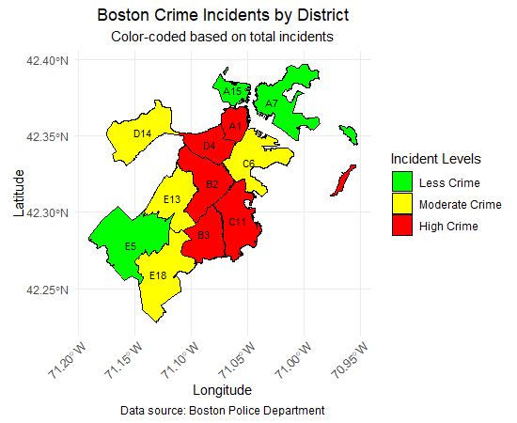
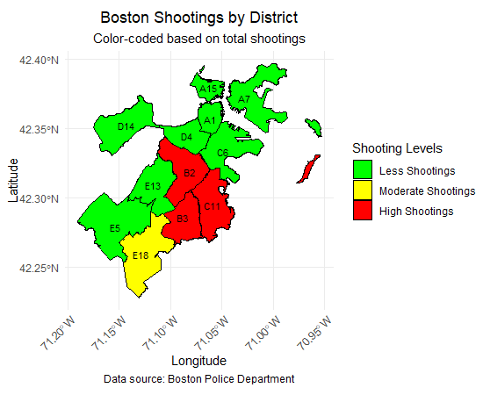
CRIME TRENDS ACROSS DISTRICTS
A1: Downtown
A7: East Boston
A15: Charlestown
B2:Roxbury
B3: Mattapan
A1: Downtown
A7: East Boston
A15: Charlestown
B2:Roxbury
B3: Mattapan
C6: South Boston
C11: Dorchester
D4: South End
D14: Brighton
E5: West Roxbury
E13: Jamaica Plain
E18: Hyde Park
C6: South Boston
C11: Dorchester
D4: South End
D14: Brighton
E5: West Roxbury
E13: Jamaica Plain
E18: Hyde Park
Higher crime: Roxbury, Dorchester, Mattapan
Moderate crime: Downtown, South Boston
Lower crime: East Boston, West Roxbury
Higher Shooting: Roxbury, Dorchester, Mattapan
Moderate Shooting: Hyde Park
Lower Shooting: East Boston, West Roxbury
Overall Insights:
The districts with the highest crime levels are concentrated in the central and southern parts of the city.
The districts with the lowest crime levels are located in the northern and eastern parts of the city.

Slide 14
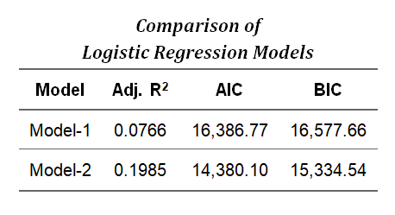
PREDICTING SHOOTING INCIDENTS
To better understand the factors contributing to shooting incidents, we use logistic regression modeling. We aim to predict the likelihood of a shooting based on factors such as district, day of the week, month, time of day, and offense category. This helps inform resource allocation and policy decisions.
Two models were developed to predict shooting likelihood.
Therefore, the second model is likely the better one.
Adjusted R-squared: The second model has a higher adjusted R-squared (0.1985) compared to the first model (0.0766). This indicates that the second model explains more of the variance in the data after adjusting for the number of predictors.
AIC and BIC: Both AIC and BIC are lower for the second model. Lower values of these information criteria generally indicate a better-fitting model.

Slide 15
MODEL EVALUATION FOR TRAIN SET
Performance matrices:
Accuracy: (TP + TN) / (TP + FP + FN + TN) = 99.10%
Precision: TP / (TP + FP) = 99.99%
Specificity: TP / (TP + FN) = 99.91%
Sensitivity: TN / (TN + FP) = 86%
Confusion matrices:
 |  | Actual Values
 | Shooting | 0 | 1
Predicted Values | 0 | True Positive 168982 | False Positive 7
 | 1 | False Negative 1512 | True Negative 43
Which misclassifications are more damaging?
False Negatives (1512) are more damaging than False Positives (7) in this context because failing to predict an actual shooting incident could have serious public safety implications.
The model shows high precision (99.99%) but lower sensitivity (86%)
This indicates the model is conservative in predicting shootings
The imbalance between FN and FP suggests the model is more likely to miss actual shooting incidents than to raise false alarms

Slide 16
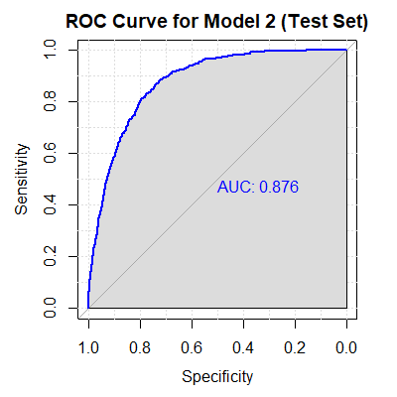
MODEL EVALUATION FOR TEST SET
Performance matrices:
Accuracy: (TP + TN) / (TP + FP + FN + TN) = 99.06%
Precision: TP / (TP + FP) = 99.99%
Specificity: TP / (TP + FN) = 99.06%
Sensitivity: TN / (TN + FP) = 94.1%
Confusion matrices:
 |  | Actual Values
 | Shooting | 0 | 1
Predicted Values | 0 | True Positive 72387 | False Positive 1
 | 1 | False Negative 686 | True Negative 16
ROC and AUC for testing sets:
Good Discriminative Power:
The ROC curve shows a strong upward trajectory, indicating that the model has good discriminatory power between positive and negative classes.
AUC of 0.876:
This AUC score suggests that the model has a high level of accuracy in distinguishing between positive and negative instances. A value closer to 1 indicates better performance.

Slide 17

RECOMMENDATIONS
Targeted Interventions:
Increase patrols in high-crime districts (Roxbury, Mattapan)
Focus resources on weekends and evening hours
Policy Suggestions:
Community engagement in high-crime areas
Enhanced traffic and medical response systems
FUTURE WORKS
Expanding analysis to include 2024 data.
Investigating socio-economic impacts on crime trends.

Slide 18

REPORT SUMMARY
Overall Crime Trends:
Consistent Patterns: Certain districts (Roxbury, Mattapan) consistently have higher crime rates, while others (Charlestown, East Boston) have lower rates.
Seasonal Variations: Crime rates tend to increase during warmer months, particularly in the evening hours.
Day-of-Week Patterns: Fridays and weekends tend to have higher crime rates.
Specific Offense Trends:
Vehicle Accidents and Medical Assistance: These are the most frequent offense categories, highlighting the importance of traffic safety and emergency response.
Larceny and Property Crimes: These offenses are prevalent in certain districts, particularly in urban areas.
Drug Violations and Violent Crimes: While less frequent, these offenses can have significant societal impacts.
Model Performance:
Model 2 shows strong discriminatory power with an AUC of 0.876, indicating good performance in distinguishing between positive and negative classes.

Slide 19
REFERENCES
City of Boston. (n.d.). Crime incident reports: August 2015 to date (source new system). Retrieved November 29, 2024, from https://data.boston.gov/dataset/crime-incident-reports-august-2015-to-date-source-new-system
City of Boston. (n.d.). City council districts 2023-2032. Retrieved November 29, 2024, from https://data.boston.gov/dataset/city-council-districts-2023-2032/resource/9255bfcb-857d-4e2a-8040-eac31d106c98
Boston Planning & Development Agency. (n.d.). Neighborhoods. Retrieved November 29, 2024, from http://www.bostonplans.org/neighborhoods
Sjoberg, D. (n.d.). gtsummary. Retrieved from https://www.danieldsjoberg.com/gtsummary/
R-Bloggers. (2015, September). How to perform a logistic regression in R. Retrieved from
https://www.r-bloggers.com/2015/09/how-to-perform-a-logistic-regression-in-r/
GraphPad. (n.d.). Logistic regression and ROC curves. Retrieved from https://www.graphpad.com/guides/prism/latest/curve-fitting/reg_logistic_roc_curves.htm
GeeksforGeeks. (n.d.). Confusion matrix in R. Retrieved from
https://www.geeksforgeeks.org/confusion-matrix-in-r/

Slide 20

Q/A
Open Discussion

Slide 21
THANK YOU!

